Slide 1



PROGRESS REPORT
Machine Learning Project
MOVIE RECOMMENDATION ENGINE

Slide 2

Report Contents
PART 1
PART 2
PART 3
Understanding
Activites
Results
Introduction
Problem Statement
Progress
Filtering techniques
Implementation
Action Steps
Algorithms

Slide 3


PART 1
What is a Recommendation System?
A recommendation system is an extensive class of web applications that involves predicting the user responses to the options.
- Refered from Medium

Slide 4
PART 1
Filtering Techniques
Collabarative
Content Based
Hybrid
collaborative filtering is a method of making automatic predictions about the interests of a user by collecting preferences or taste information from many users (collaborating).
Content-Based recommender system tries to guess the features or behavior of a user given the item’s features, he/she reacts positively to.
Hybrid recommender systems combine two or more recommendation strategies in different ways to benefit from their complementary advantages.

Slide 5






Algorithms
Singular Value Decomposition (SVD)
A lesser known algorithm,used by Netflix recommender engine.
K Means
k means clustering is and unsupervised learning that is used for clustering

Slide 6


Recommending user movies based on different parameters by taking input as movie name and giving the output as movie suggestions along with similarity score.
PART 2
Problem
Statement

Slide 7

PART 2
Action Step 2
Pre Processing, Data Visualization and Modelling
Action Step 1
Action Step 3
Understanding the problem statement and concepts
Deploying our recommender system
Action Steps

Slide 8
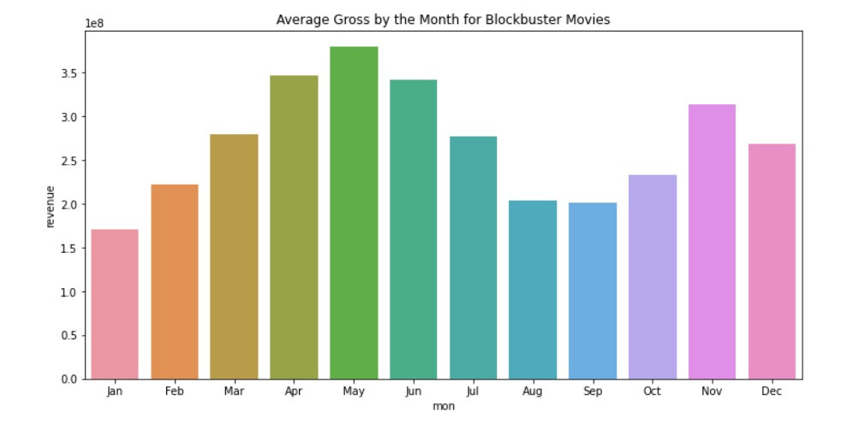
PART 3
Data Visualization

Slide 9
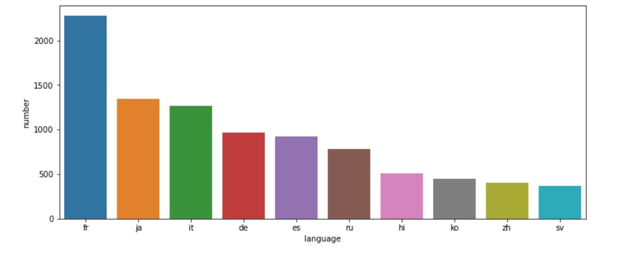

Slide 10
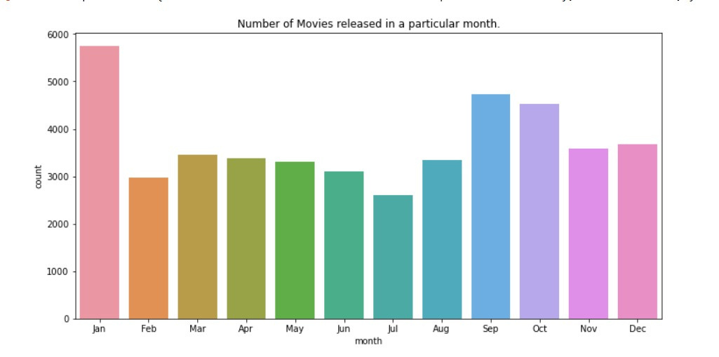

Slide 11
PART 2
Algorithm | RMSE/MAE | Training and Testing
K-Means | 0.93803/0.73280 | 80:20
SVD | 0.93894/0.74542 | 75:25
LightFM | 0.89712/0.70910 | 85:15
Demonstration Link
Results

Slide 12




Team Members
Team
Rohan Sharma
Sai Harsha Vardhan AVN
Mudra Kevadia
Venkatsaigautam Bhatina

Slide 13

Thank you!

